Slide 1
NATIONAL INSTITUTE OF TECHNOLOGY, MANIPUR
Langol, Imphal, Manipur - 795004
DEPARTMENT
OF
CIVIL ENGINEERING
Vision
To become, an engineering educational institution of international standing by striving continuously in pursuit of excellence in education, research, entrepreneurship and technology related services to the society.
Mission
To impart quality education to build competitive and creative young engineers by keeping pace with rapidly changing technologies and to become a leading Centre of Excellence in Civil Engineering Education and Research.

Slide 2
About the Department
The Department of Civil Engineering was established in the year 2013. The Department provides outstanding teaching, research & consultancy environment. The Department offers for admission in B.tech. course with an intake of 30 students, M.Tech course with an intake of 15 regular & 5 part time students and PhD students. The Department has an objective to produce quality engineers to meet the ever growing demand for technical manpower in the Civil Engineering arena.
Foreward from the Head of Department
Civil Engineering is a broad field of engineering which involves planning Design, construction maintenance and management of structures or public works.
Civil Engineering Department of NIT MANIPUR aims at developing analytical and experimental skills in students to apply in various fields of Civil Engineering.
The emphasis is laid on proper understanding of the fundamentals of the subjects through animation, video clips and case studies. The department has well equipped laboratories, computational facilities; modern class rooms and provides a good environment for learning.
The department also provides an opportunity for students in improving communication and presentation skills, knowledge of software like Auto CAD, STAAD PRO, SAP and Arc GIS. For students the department consistently organizes Industrial Training and visit to live projects to gain practical knowledge and understanding of field constraints.
-Dr. Thiyam Tamphasana
Conference & Workshop
A one day Workshop on “ Water and sustainable development on World water day, 22nd March 2015
A one day “Awareness programme on potential of space technology and its applications”, 27th September 2016

Slide 3
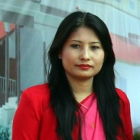
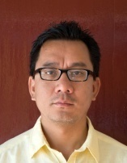
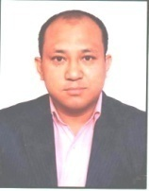
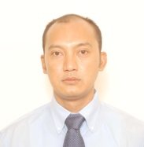
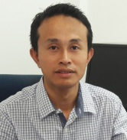
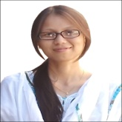
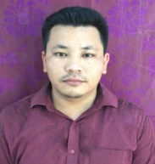
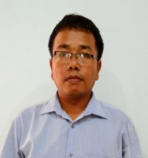
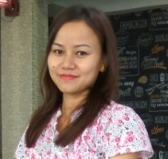
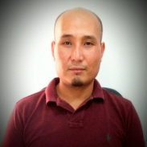
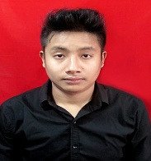
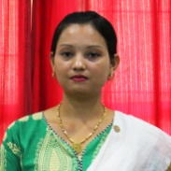
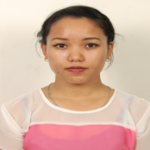
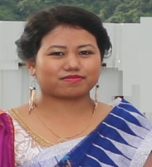
Faculties & Staffs
Dr. Th. Tamphasana Devi (Ph.D, IIT Guwahati)
Assistant Professor
Head of Department
Former: Departmental Ph.D admission co-ordinator
Member Institute Purchasing Committee
Member Boy’s Hostel disciplinary committee
Dr.Bakimchandra Oinam (Ph.D,University of Stuttgart, Germany)
Assistant Professor
Former : Associate Dean Planning & Development
Dr. P. Albino Kumar (Ph.D, IIT Guwahati)
Former faculty at
Delhi Technical University
Erstwhile Delhi college of engineering
Assistant Professor (Environmental engineering)
Former : Associate Dean Academics
Co-ordinator Unnat Bharat Abhiyan
Co-ordinator Swachh Bharat Abhiyan
Head of department
Dr. Ng. Romeji (Ph.D, IIT Roorkee)
Former Scientist at ISRO
Assistant Professor
Co-ordinator Training & Placement
BOG Member
Co-ordinator Solar Panel Cell NIT Manipur
Dr.M.Sunil Singh (Ph.D, NIT Silchar)
Assistant Professor
Examination Co-ordinator
MOOCs Remote Center Co-ordinator
Chairman Innovation Club NIT Manipur
Dr. W. Victory (Ph.D, NIT Silchar)
Lecturer
Transportation engineering
Mr. M. Nongthouba
(Pursuing Ph.D, NIT Silchar)
Lecturer
Structural engineering
Mr.Kh. Sachidananda
(Pursuing Ph.D, IIT Gauwahati)
Lecturer
Structural engineering
Ms. S. Pipileima
(Pursuing Ph.D, NIT Manipur)
Lecturer
Environmental engineering
Mr. I. Bigyananda
(Pursuing M.Tech, NIT Manipur)
Technical Assistant
Transportation & Surveying Lab
Mr.Koroungamba Laishram
(Pursuing M.Tech, NIT Manipur)
Technical Assistant
Fluid Mechanics & Hydraulics Lab
Mrs.Kh. Jayalalita Devi
(B.Tech, Kalasalingam University)
Technical Assistant
Environmental & Geology Lab
Ms. N. Bidyamani Chanu
(B.Tech, Anna University)
Technical Assistant
Geotechnical & Structural Lab
Ms. P. Jesiada
(B.Tech, Manipur University)
Technical Assistant
Material & Computational Lab

Slide 4
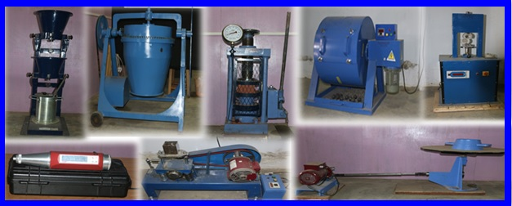
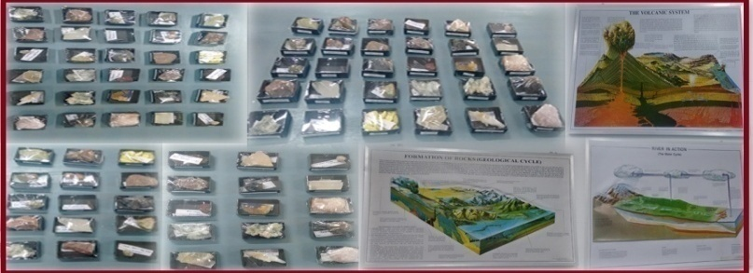
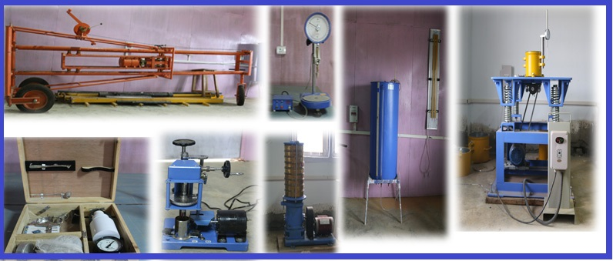
Laboratory Details
Computational Lab
Transportation Lab
Hydraulics and Hydraulic machine Lab
Fluid mechanics Lab
Material Testing Lab
Engineering Geology Lab
Environmental Engineering Lab
Surveying Lab
Geotechnical Engineering Lab
The department Laboratory has high well advance & sophisticated equipments from Gunt Hamburg, Germany such as Hydraulics machine, Fluid mechanics & structural engineering equipments.
Equipments for water analysis, Atomic Adsorption Spectrometer from PerkinElmer, USA.

Slide 5
Study Tour
Tupul Mini power hydel project
Sewage treatment plant
Dollaithabi Dam
Maphou Dam (66 feet height and 107.4 metre long and capacity to generate 7.5 MW
Research Project
Development of amine based polymer adsorbent for defluoridization of drinking water-DST: Dr. P Albino Kumar.
Unnat Bharat Abhiyan: Adopting 4 village in Bishnupur District to treat and supply potable water.
Land degradation risks assessment and monitoring in Manipur, India, a multi-scale approach: Dr. Bakimchandra Oinam
Public Health Care System Facilities and Spatio-Temporal Disease Mapping and Assessment using Geospatial (GIS and GPS) Technology in Manipur, India: Dr. Bakimchandra Oinam
EOAM-Hydrological Impact Assessment with Climate & Land-use Change Dynamics of Loktak Lake Sub-basin, Manipur: Dr. Ngangbam Romeji
Internship
Bihar Rajya Pul Nirman Nigam Ltd.(Patna, Bihar)
Central Water Commission, Shillong
North East Space Applications Centre, Barapani, Meghalaya.
North East Frontier Railway, Maligaon, Guawahtai
New Delhi Railway station, Paharganj, New Delhi
National Hydroelectric Power Corporation, Loktak, Manipur
Irrigation & Flood Control Department(IFCD), Manipur
Power Grid Construction, (Lucknow,Delhi)
GAMMON India Ltd. Guwahati
Public Works Department (PWD), Manipur
Metro Rail Corporation Ltd. (Hyderabad, Lucknow)
Central Public Works Department (CPWD), Manipur
Research Development & Standard Organisation, Lucknow
North Eastern Electric Power Corporation Ltd., Shillong
MOU (Memorandum of Understanding)
The Department is in final steps to sign an MOU with the following foreign University for students & faculty exchange programs
National Pingtung University of Science & Technology, Chinese Taipei (Taiwan)
University of Stuttgart, Germany
International Student program
Thounajoam Bidyaraj (B.tech 5th Semester) attended Indian Youth Delegation to South Korea from 10th to 19th May 2017 by Ministry of Youth affairs & sports Govt. of India.
Foreign visits of Faculties
Dr. P. Albino Kumar : Invited for a talk at National Pingtung University of Science & Technology, Chinese Taipei (Taiwan) - Workshop on “2016 Youth Sustainable Water Resources Education and Hub Development in Apec Region” held on 4th to 8th September 2016 .
Dr. Bakimchandra Oinam : Visited at Universitaet Tuebingen, Germany to attend a workshop on “Re-invitation Programme for Former Scholarship Holders”, 2016 held on 26th June to 15th July 2016

Slide 6
Testing & Consultancy
The department of Civil engineering NIT Manipur offers its services to the construction industry, Government & Semi Government sectors and private firms to carry out various routine and specialized tests on civil engineering materials.
(Structure, Transportation, Soil, Environmental)
Clients :- Power Grid, LIC, HCC, Police Housing, Railways & more.
Objectives
To nurture and develop talented young minds, encouraging creativity with academic excellence.
To provide a platform to young entrepreneurs and technocrats to experiment their dreams and aspirations.
To encourage faculty and students to conduct research of international standard.
To produce students fulfilling the employability criteria of MNCs.
To set up Laboratories with latest equipment and other facilities.
To set up international standard infrastructure for extra curriculum activities.
Placement opportunities
The Institute has been visited by number of companies for campus recruitment of our civil engineering graduates. The placement record of the student for the first batch of graduates passing out from our college has been fairly good.
Contact
Head of Department
Department of Civil Engineering
National Institute of Technology, Manipur
Langol, Imphal, Manipur 795004
E-mail: hodcivil@nitmanipur.ac.in

